Slide 1
Muslim Prayer Reminder Game
Mohammad Faraj
23077476

Slide 2
Introduction
Use Case and Objective:
Notify the user with prayer time.
Inform the user with the current time.
Gamify praying.
• Why does this prototype matters?
Important for helping Muslims with their daily prayers, specially in places with no nearby mosques.

Slide 3
Understanding the Target User
• Muslims need to pray 5 prayers a day, all related to different times of the day, which is hard to notice if indoor or far from a nearby mosque.
• There is a period between each prayer where the user shall pray this prayer in, sometimes it is hard to remember to pray on time, specially if you are trying to make it as a new habit.
A kid that is learning how to pray.

Slide 4
Design of your Hi-Fidelity Prototype
• Prototyped a simple smart device using Raspberry Pi Pico, Breadboards & Jumping wires, API for prayer timings, etc.
• Includes:
LCD Display: to display messages to user, current time, time left for next prayer, score, etc.
Press Button: to used as a sensor that takes input from the user, did you pray? Y/N.
Buzzer: to make beep sounds that shall remined and notify the user with the prayer.

Slide 5
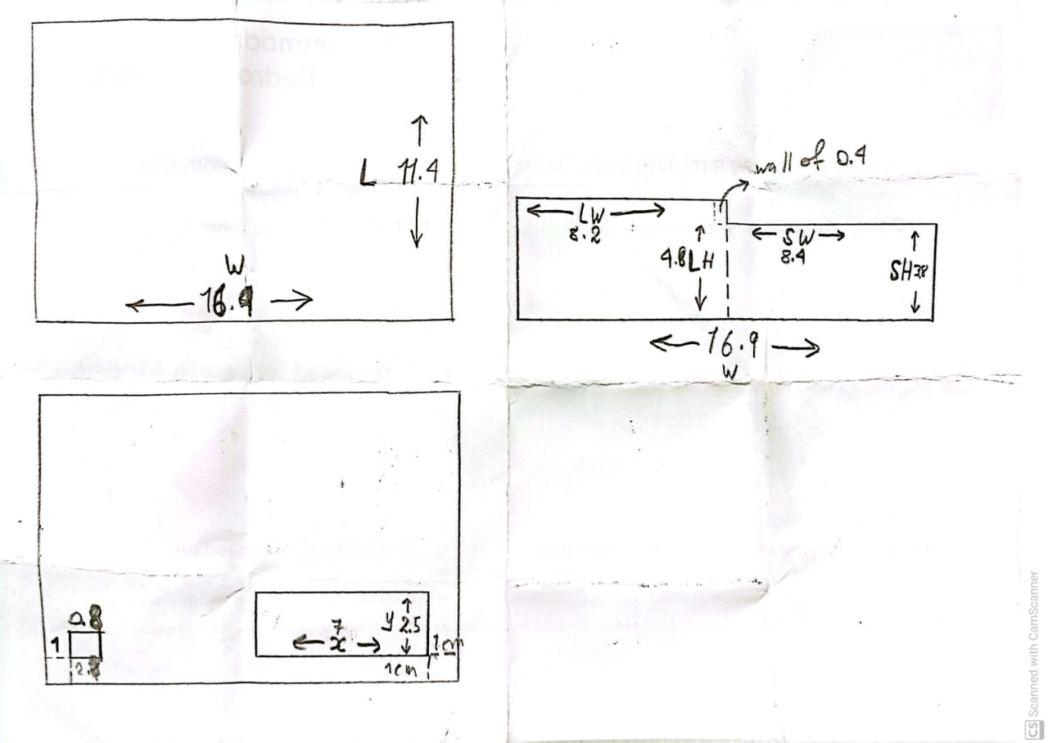
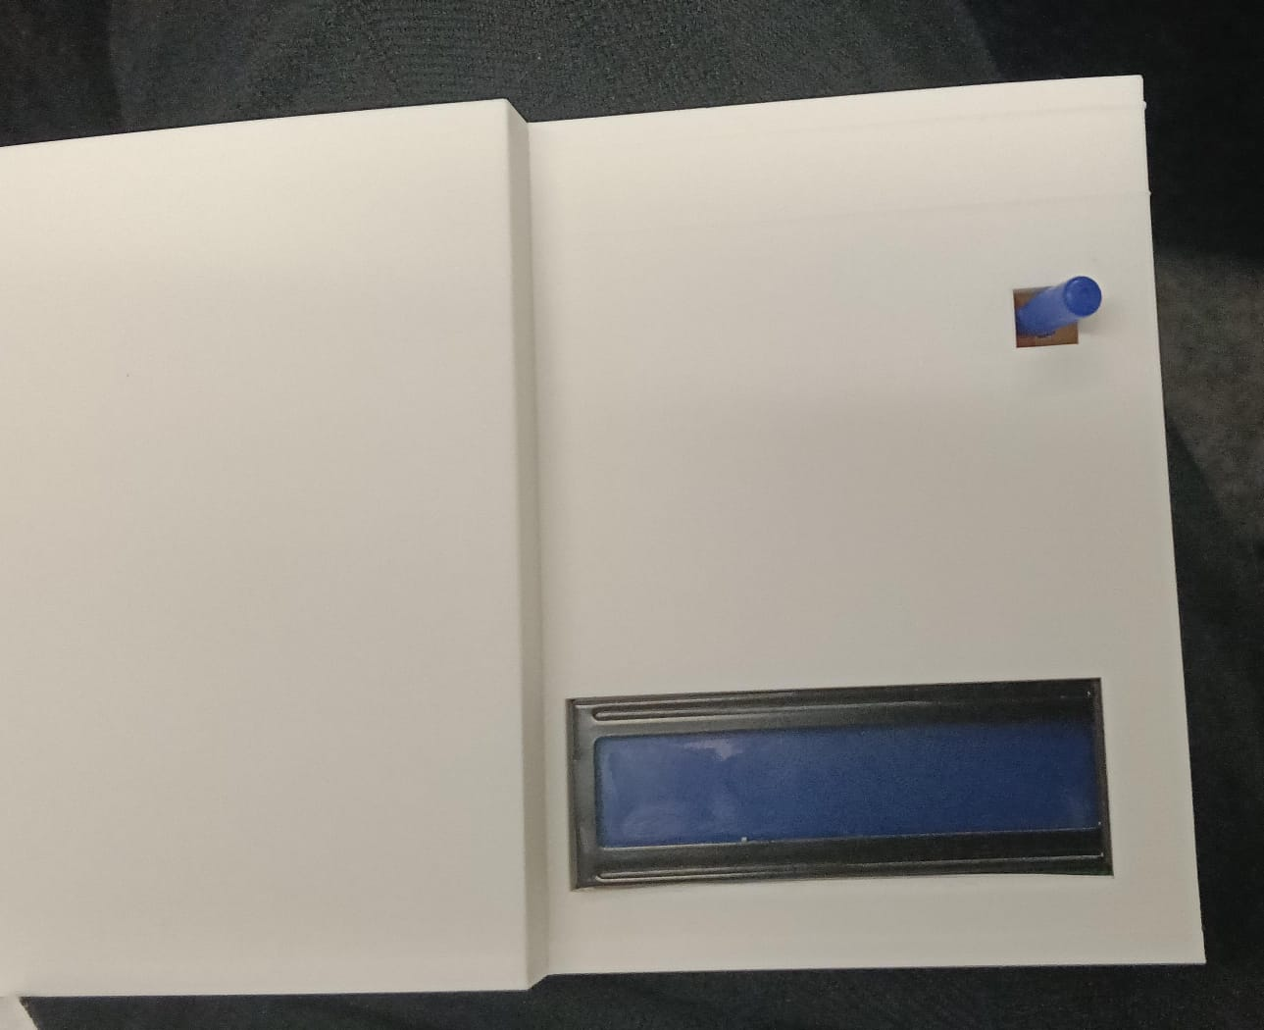
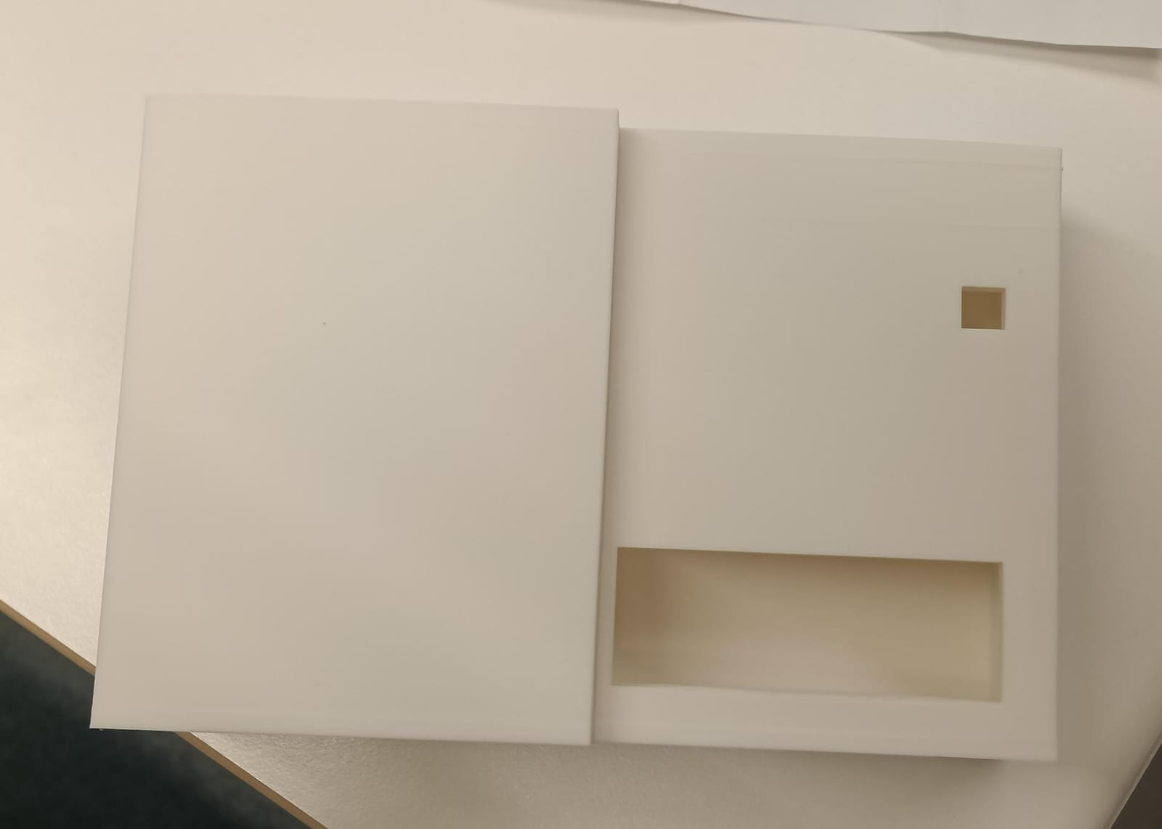
Improvements and Future Work
Problems faced:
Sometimes the API used for fetching prayer times, glitches and can’t give prayer times, which needs to be reset.
Designed a 3D box to serve as a container for the device, but it didn’t fit.

Slide 6
Improvements and Future Work
A Dual-band GPS/RTK could’ve been used to give accurate times globally.
To become a product, it needs to be:
Smaller.
Has a rechargeable battery (portable).
Has a more cheerful and friendly outer design.

